Slide 1
BDSN ASSIGNMENT
BY
SUBHASMITA MISHRA(A21033)
PRAXIS BUSINESS SCHOOL

Slide 2
PROBLEM STATEMENT
CUSTOMER CHURN PREDICTION WITH PYSPARK
DESCRIPTION:
Predicting customer churn with PySpark for an imaginary digital music service called Sparkify. Sparkify has a free plan and a premium subscription plan. Users can upgrade, downgrade or cancel their service at any time. Churn means downgrading from premium to free plan or cancelling the service. Here if we can predict customers who will churn, the company can offer them discounts and incentives to make them stay.

Slide 3
DATASET
In this project I used two dataset
customer_churn.csv
mini_sparkify_event_data.json(https://udacity-dsnd.s3.amazonaws.com/sparkify/mini_sparkify_event_data.json)
json file that keeps track of time stamped events of digital music service like:
Login
Playing a song
listening to an advertisement
Downgrading or canceling subscription
Logout

Slide 4
PROCEDURES
First step I loaded the data into my environment. I read the 128MB dataset into a spark dataframe.
As I begin exploring loaded data, i cleaned dataset so that it can be ready to build machine learning models.
Then i made some cleaning and some transformations on dataset for exploratory data analysis and data visualization
In this project, I tested 3 different models-Logistic Regression Model, Gradient Boosted and Random Forest Algorithms. For each model built, I evaluated them based on accuracy and F1 score.

Slide 5
PROCEDURES
In this project, I implemented a python notebook that loads, explores, and cleans customer data which is then used to build a machine learning model that can predict customer churn.
I built 3 machine learning models which are 1. Random Forest, 2. GBT Classifier Model and 3. Logistic Regression Model. After comparing the Accuracy and F1-Score for each model. Atlast I determined that Logistic Regression Model was best balanced for predicting customer churn.

Slide 6
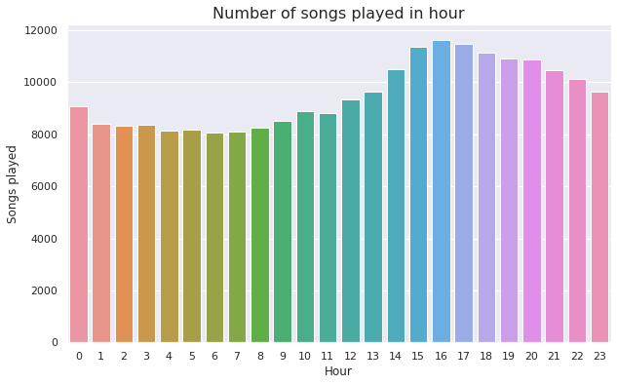
FINDINGS

Slide 7
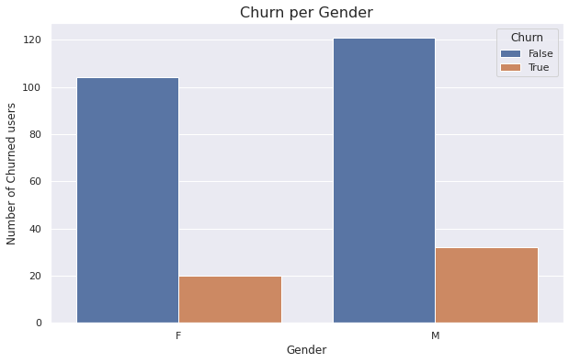
FINDINGS

Slide 8
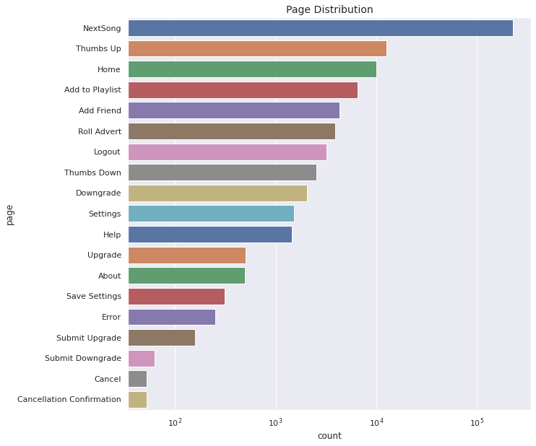
FINDINGS

Slide 9
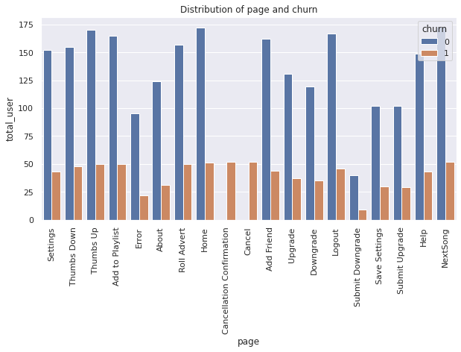
FINDINGS

Slide 10
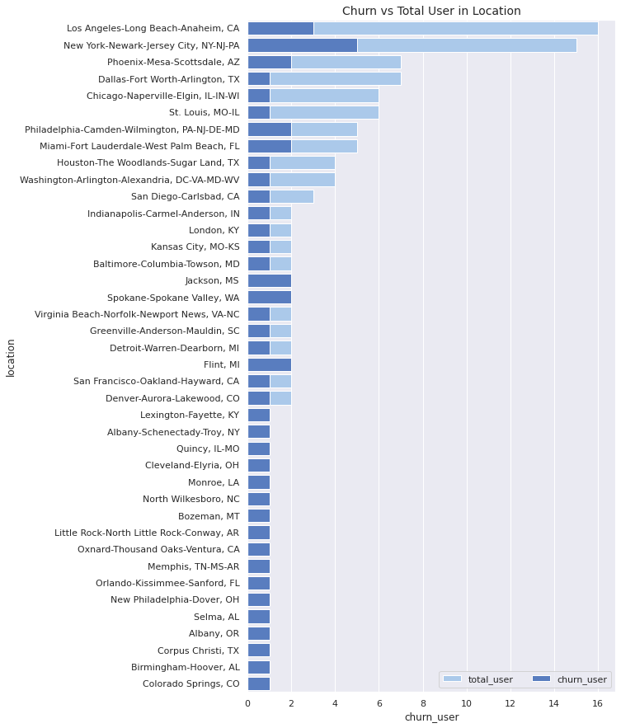
FINDINGS

Slide 11
Predicting customer churn is a challenging and common problem that data scientists and analysts face in any customer-facing business. The analysis and modeling completed here is to highlight the process of a machine learning project using Spark.

Slide 12
CONCLUSION
Spark provides us with a generalizable framework to predict churn. It can handle big data for any company provided it is deployed on a cluster that can handle the computations required
Finally, it is important that this model be re-trained regularly as mitigating actions are implemented and the user base grows and evolves, in order to make this model adapt to changing conditions.

